Slide 1
3D Image Segmentation and Quantification of Lysosomes
25/12/2025

Slide 2
FILES
40A_UAS-TMEM1923x-HA x 71G10 40A MARCM_L3_1_Airy_010724
Airy scan_40A_UAS-TMEM-HA_CB_0h_1_051222

Slide 3
40A_UAS-TMEM1923x-HA x 71G10 40A MARCM_L3_1_Airy_010724

Slide 4
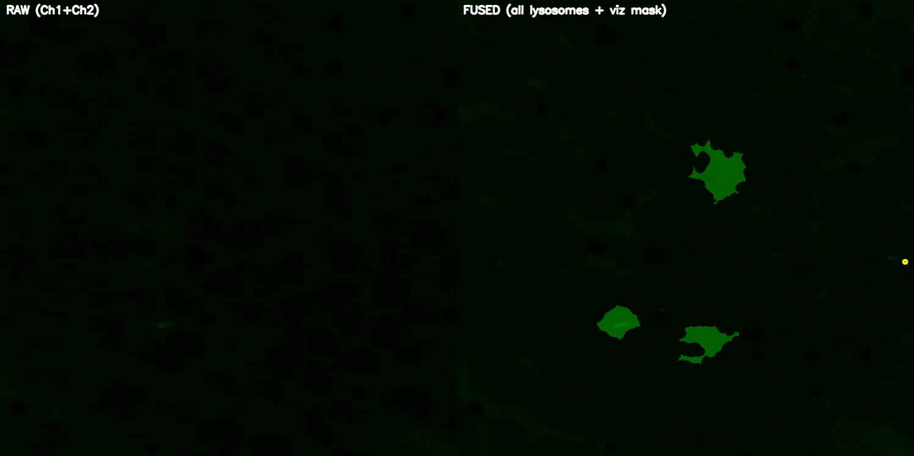
DETECTION VIDEO

Slide 5
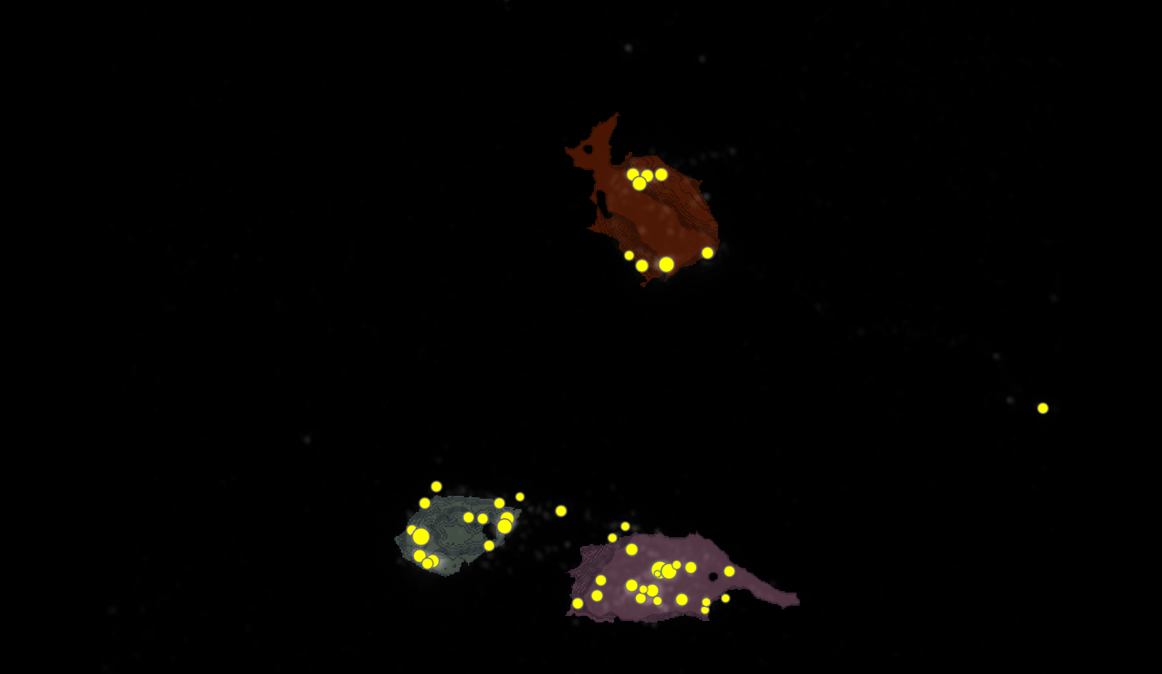
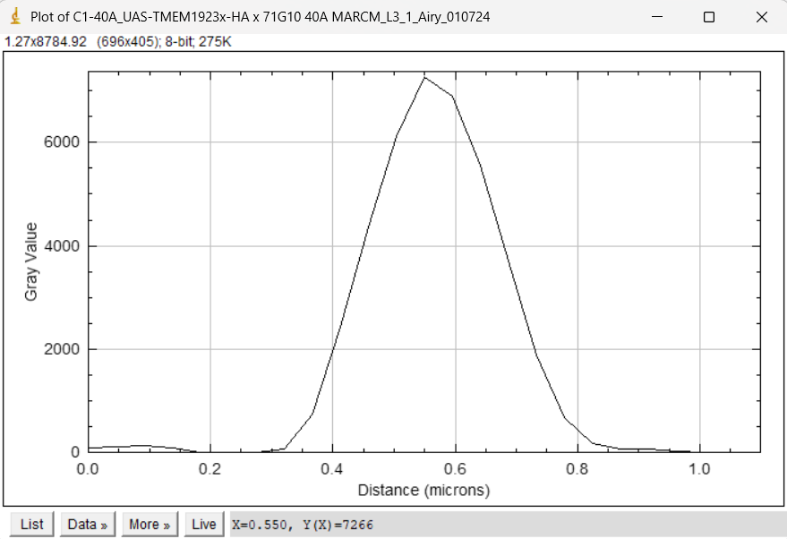
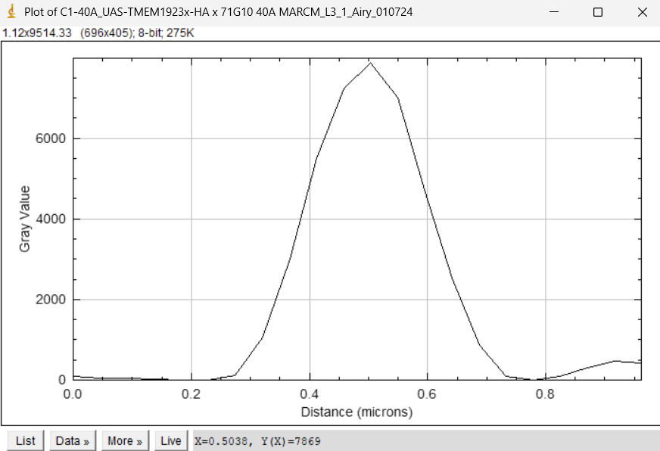
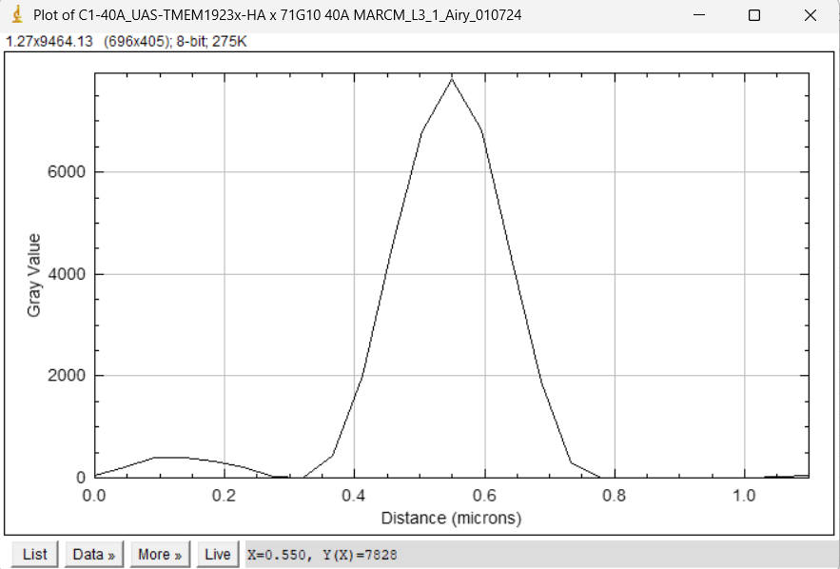
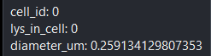
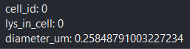
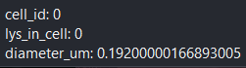
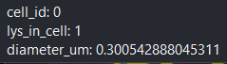
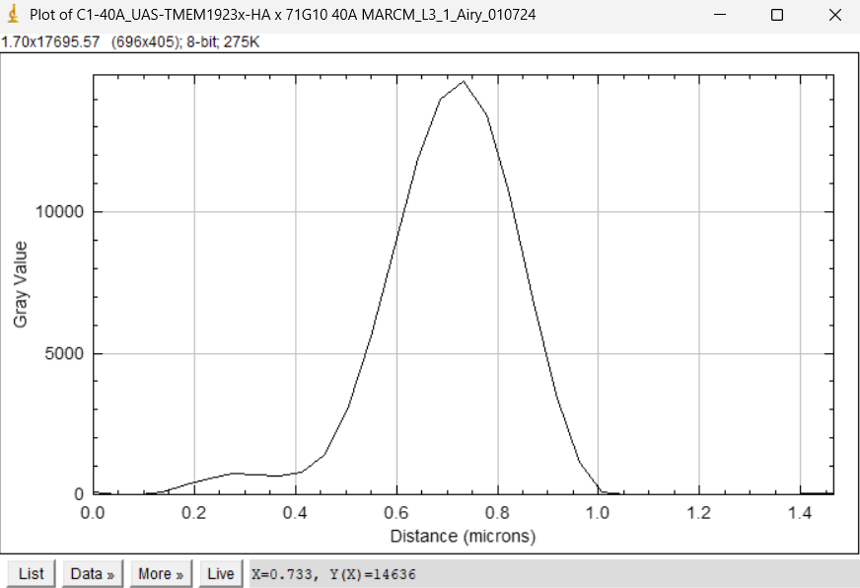
SEGMENTATION
1
2
3

Slide 6
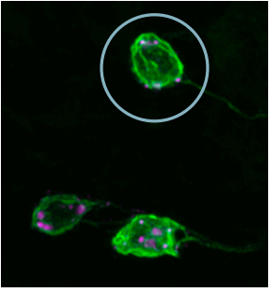
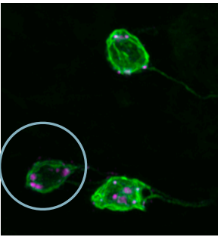
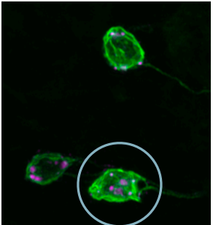
MANUAL.vs.AUTOMATIC
1
2
3

Slide 7
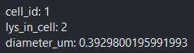
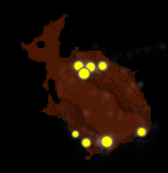
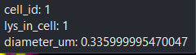
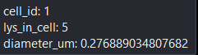
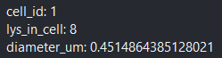
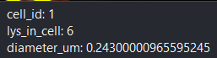
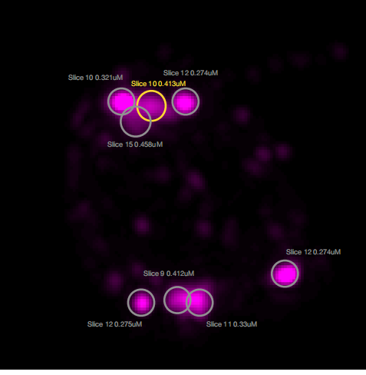
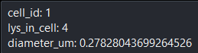
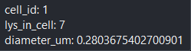
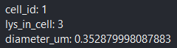
MANUAL.vs.AUTOMATIC
1
2
1
5
8
3
6
4
7

Slide 8
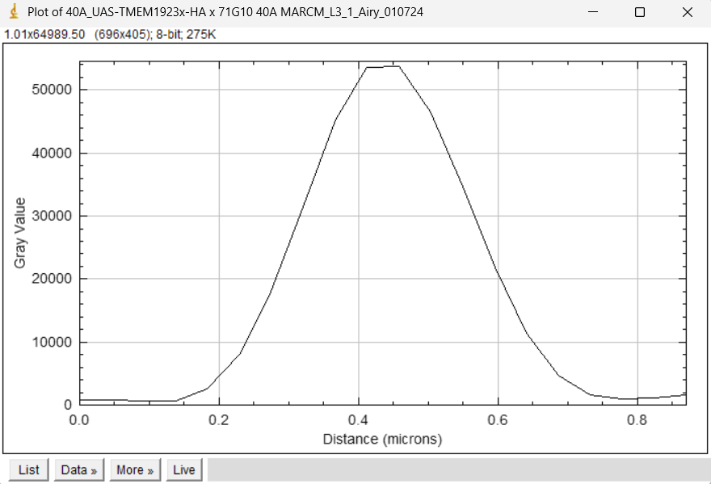
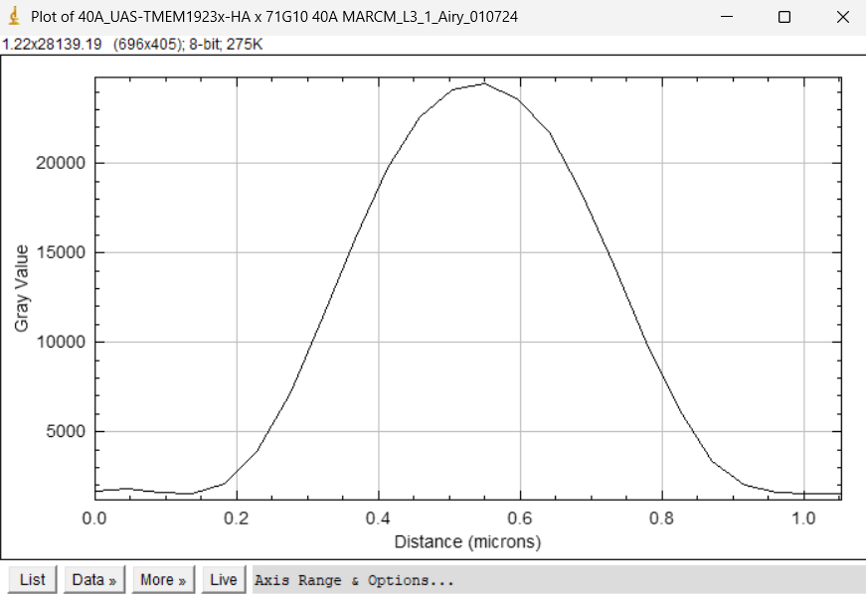
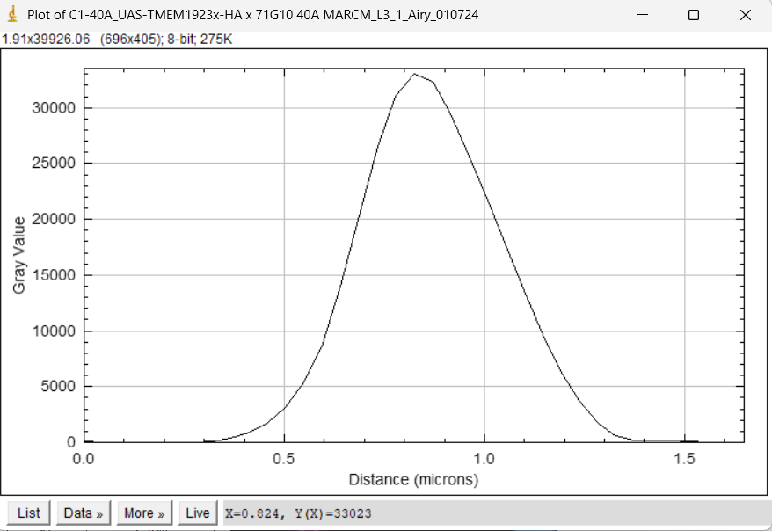
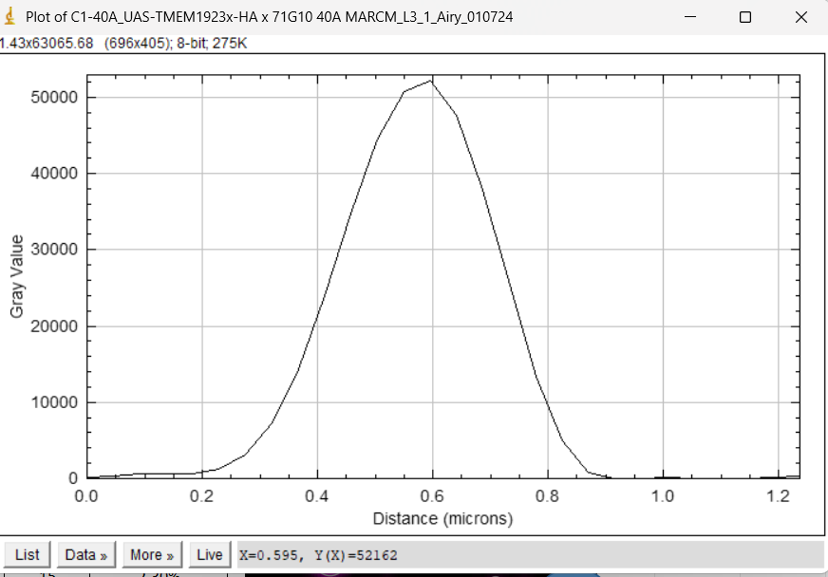
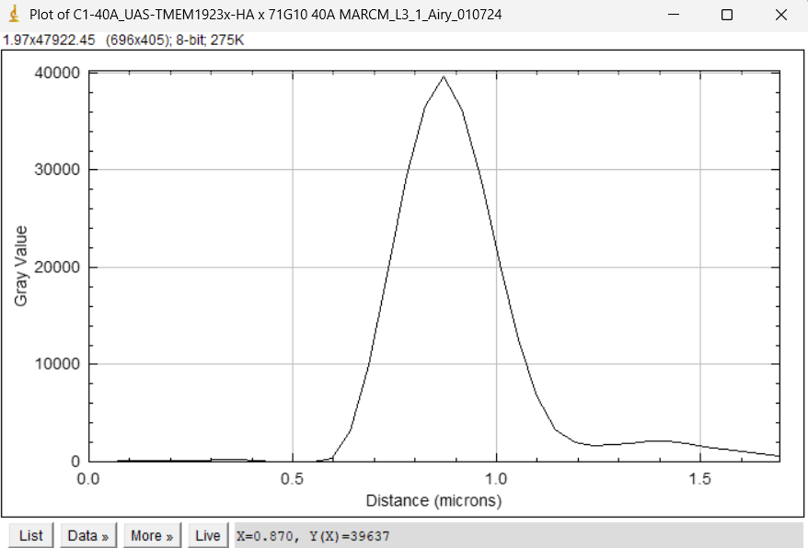
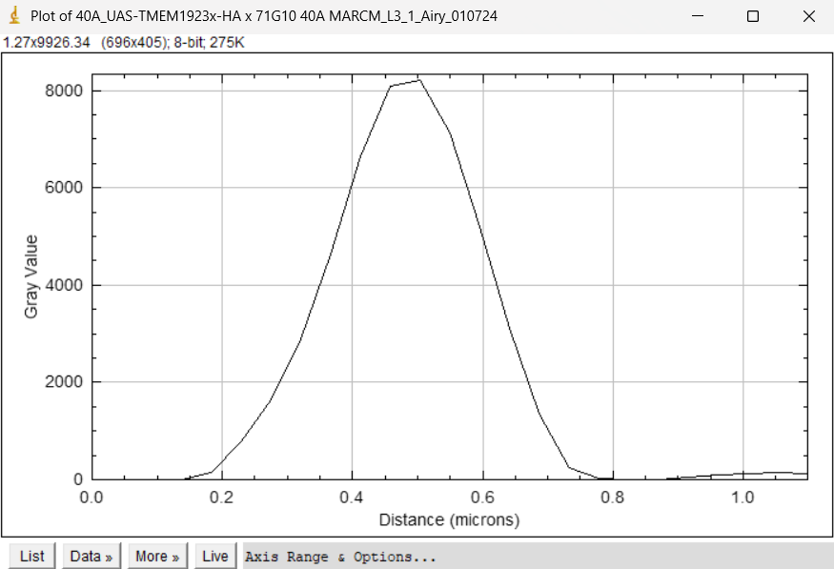
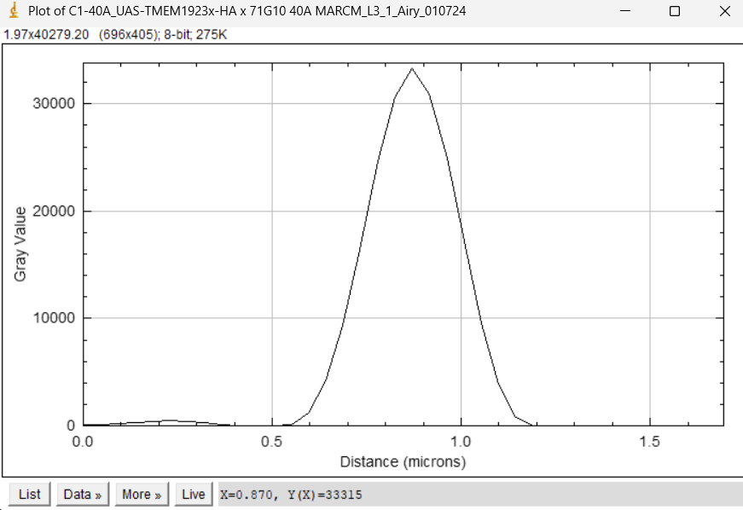
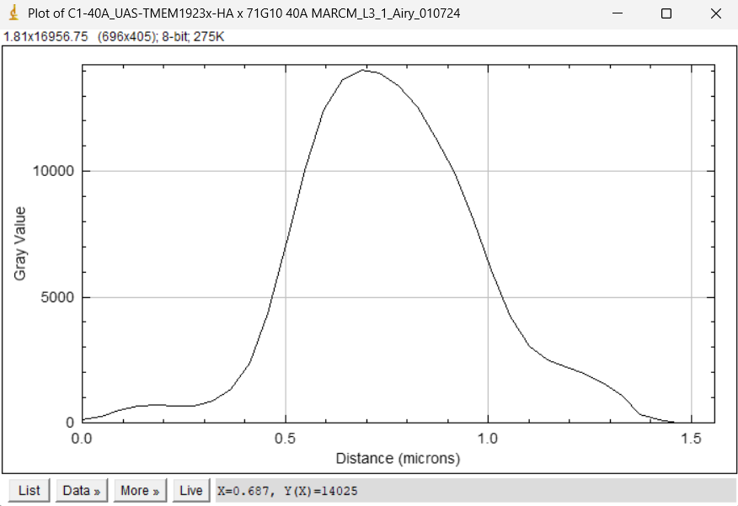
PEAKS PER LYSOSOME WITH IMAGE(CELL 1)
1
2
3
4
5
6
8
7

Slide 9
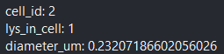
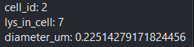
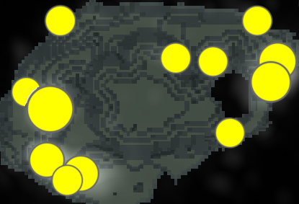
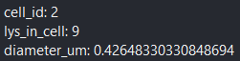
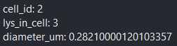
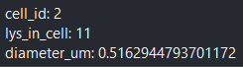
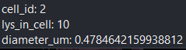
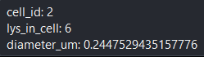
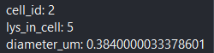
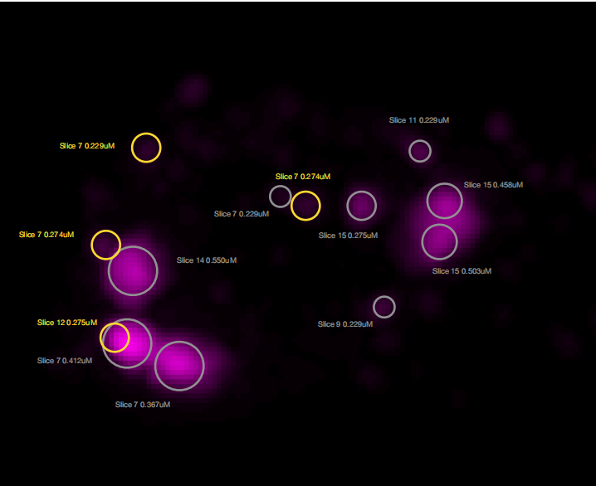
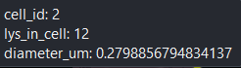
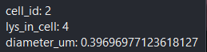
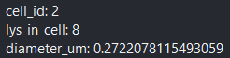
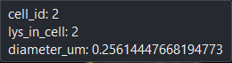
MANUAL.vs.AUTOMATIC
2
7
1
12
3
11
9
2
4
10
5
6
8

Slide 10
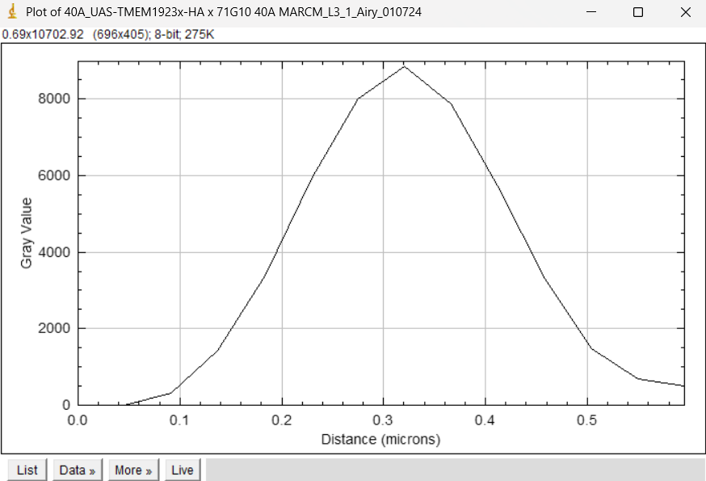
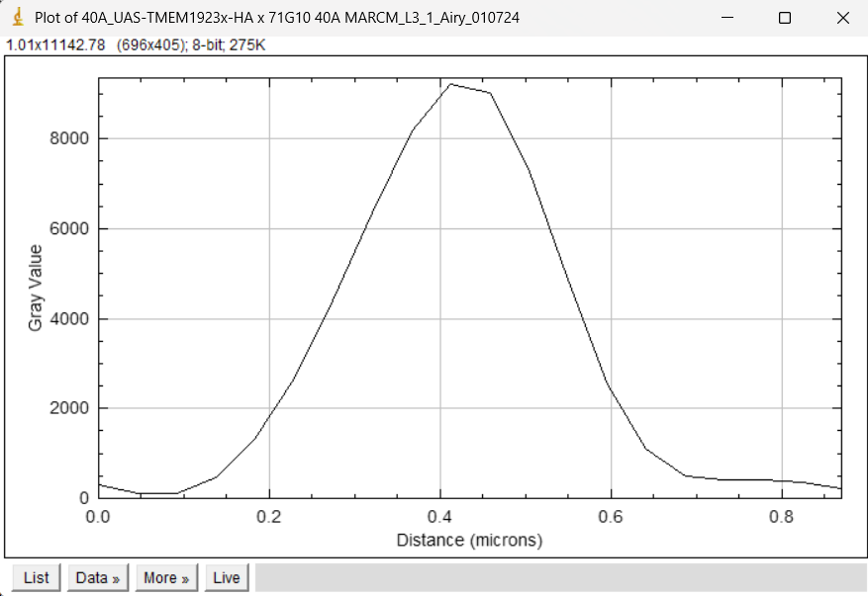
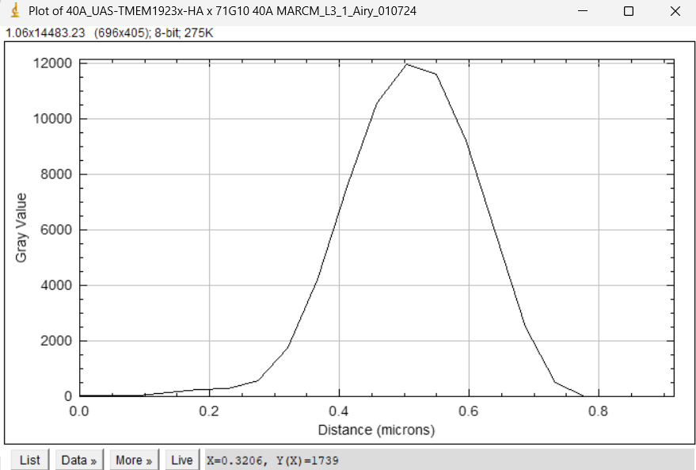
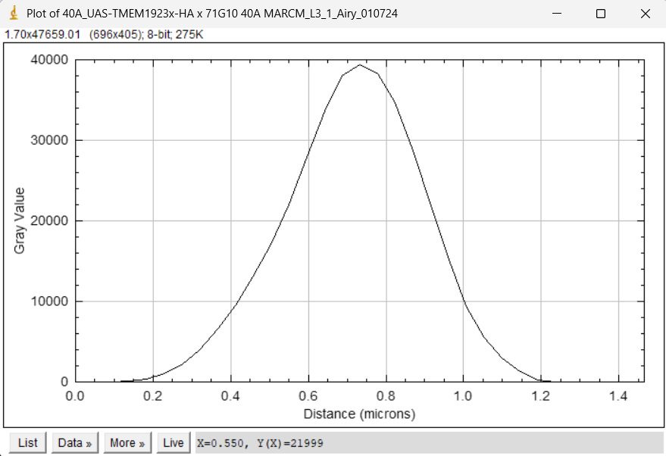
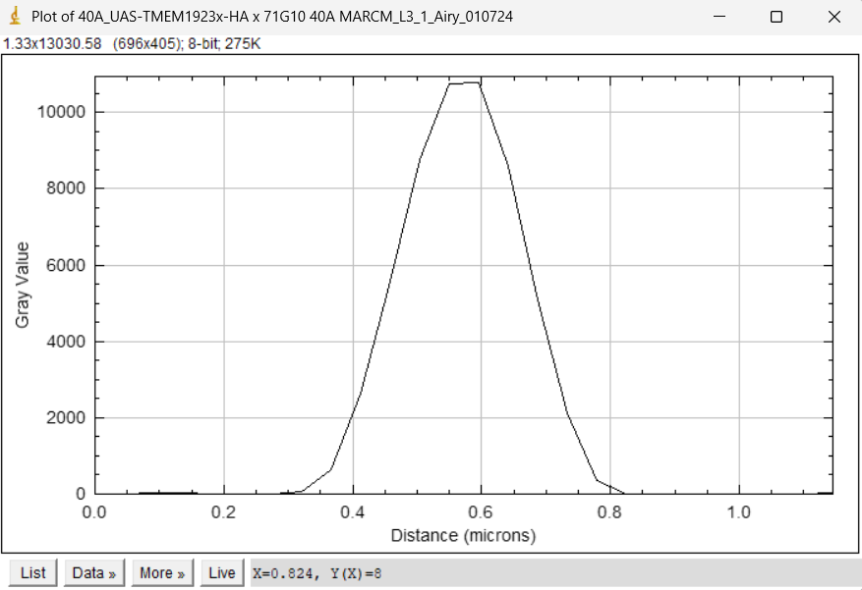

PEAKS PER LYSOSOME WITH IMAGE(CELL 2)
1
2
3
4
5
6

Slide 11






PEAKS PER LYSOSOME WITH IMAGE(CELL 2)
7
8
9
10
11
12

Slide 12























MANUAL.vs.AUTOMATIC
17
10
3
16
8
11
2
1
3
5
13
18
19
12
9
7

Slide 13









PEAKS PER LYSOSOME WITH IMAGE(CELL 3)
1
2
3
4
5
6
7
9
8

Slide 14









PEAKS PER LYSOSOME WITH IMAGE(CELL 3)
10
11
12
13
14
15
16
17
18

Slide 15



PEAKS PER LYSOSOME WITH IMAGE(CELL 3)
19
20
21

Slide 16


DATASETS WITH PEAKS

Slide 17




DATASET LYSOSOMES(ORDER FOR CELL ID)

Slide 18



DATASET LYSOSOMES

Slide 19
Airy scan_40A_UAS-TMEM-HA_CB_0h_1_051222

Slide 20

DETECTION VIDEO

Slide 21

SEGMENTATION
1
3
5

Slide 22



MANUAL.vs.AUTOMATIC
1
3
5

Slide 23
















MANUAL.vs.AUTOMATIC
3
7
3
5
1
4
8
4
6
1
2
2

Slide 24









MANUAL.vs.AUTOMATIC
4
3
1
2
5
6
7

Slide 25







PEAKS PER LYSOSOME WITH IMAGE(CELL 1)
1
2
3
4
5
6
7

Slide 26




PEAKS PER LYSOSOME WITH IMAGE(CELL 3)
1
2
3
4

Slide 27








PEAKS PER LYSOSOME WITH IMAGE(CELL 5)
1
2
3
4
5
6
7
8

Slide 28


DATASETS WITH PEAKS

Slide 29




DATASET LYSOSOMES(ORDER FOR CELL ID)

Slide 30



DATASET LYSOSOMES

